Slide 1
Calibration of Space Charge and Grid Leak
Xiaohai Jin
Feb 10 2019

Slide 2
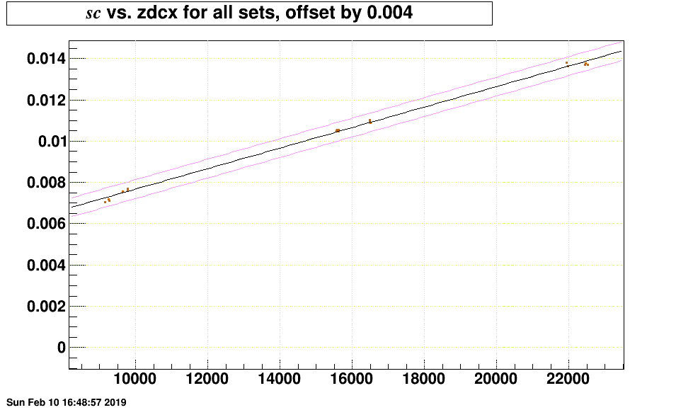

Slide 3
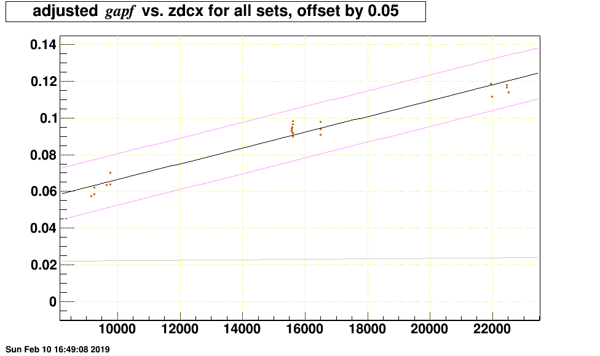

Slide 4
